Slide 1
Comparing Neighborhoods in Toronto and Mumbai
IBM DATA SCIENCE SPECIALIZATION
CAPSTONE PROJECT

Slide 2
Introduction
Toronto is the capital city of Canadian province of Ontario. It is the most populous city in Canada, a multicultural city, and Canada's financial and commercial center. It is home to more than 2,731,571 people spread over an area of 630.2 sq. km.
Mumbai is the capital city of Maharashtra state of India. It is the largest city in India, being a cultural and financial center for the country. It is home to more than 12.5 million people spread over 603.4 sq. km.
Despite being so far apart from each other, Mumbai and Toronto share a few characteristics:
Similar sizes.
Both cities are financial centres of their respective country.
Both cities have a vibrant culture and strong commerce sector.

Slide 3
Project Goal
Analyzing how different the neighborhoods in both these cities are by utilizing the location data of their neighborhoods and different venues present in them.
Utilizing Foursquare API and getting accustomed to its utilization.
Using Machine Learning techniques in fulfilling primary goal.

Slide 4
Methodology
The goal is to analyse the difference between the neighborhoods of Mumbai and Toronto. The data required for this problem includes neighborhood names and their respective location data followed by the venue data for each neighborhood.
Location Data:
This project utilizes neighborhood names and location data scrapped from Wikipedia articles of Toronto Neighborhoods and Mumbai Neighborhoods read through BeautifulSoup4 and Pandas libraries in python. This data is then used to get appropriate location encodings, if absent for respective neighborhoods.
There are 103 records in Toronto neighborhood data each containing multiple neighborhoods while there are a total of 93 records in Mumbai neighborhood data each containing single neighborhood.

Slide 5
Venues Data:
The data for recommended venues in each neighborhood is procured using Foursquare API. This data is further modified by getting the main category for each venue instead of the sub category gotten through api request. The data is then filtered to remove venue categories with less than 10 instances in all neighborhoods which further reduces the no of features we will work with while clustering neighborhoods.
Final Data preparation step consists of one-hot encoding the category column to get proper features for each venue. Further grouping by neighborhood is done with aggregate function being sum.
Lastly the data is utilized in clustering algorithm to cluster similar neighborhoods and for further analysis.

Slide 6
Results
The Location Encodings for 103 records in Toronto dataframe were utilized to plot the distribution of the neighborhoods in Toronto.

Slide 7
The Location Encodings for 93 records in Mumbai dataframe was utilized to plot the distribution of neighborhoods in Mumbai.
Most of the neighborhoods in both cities are situated near the water source (Lake Ontario for Toronto and Arabian Sea for Mumbai). This signifies the importance of water route for transportation for both cities as they are commercial hubs.

Slide 8
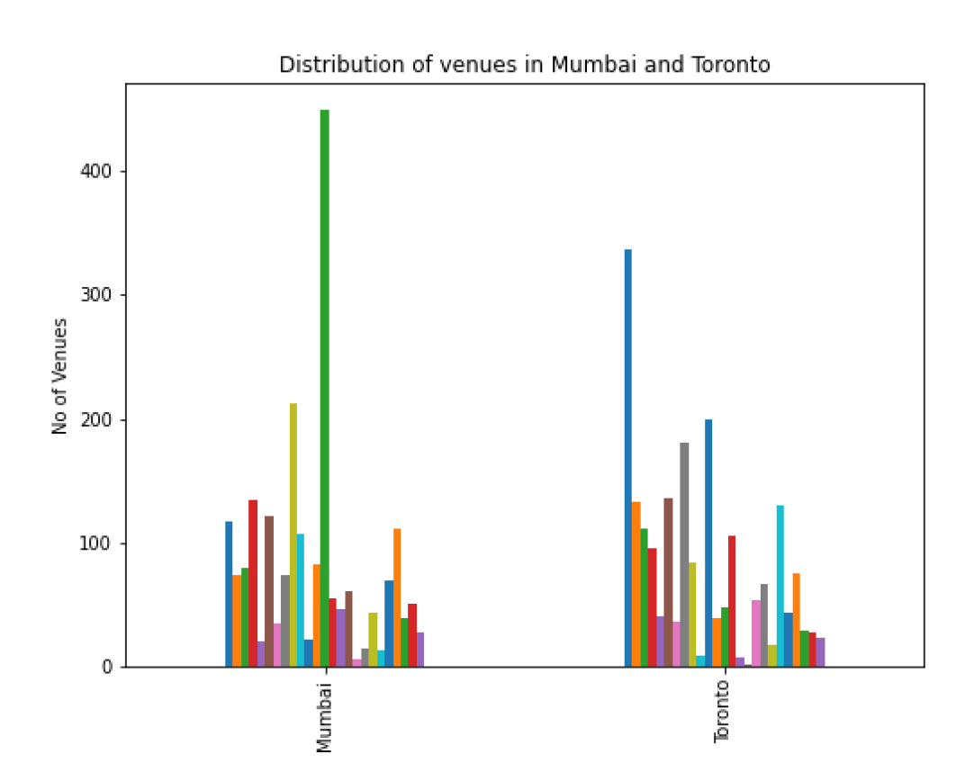
A total of 5851 venues were requested successfully and stored in a dataframe. There were 187 categories for the venues, which were reduced to 25 by removing venues of categories which had a frequency of less than 50 (total 162 categories removed).

Slide 9
Conclusion
Mumbai and Toronto despite having their similarities have a very different distribution of venues categories.
Despite the difference in between cities, many of the neighborhoods have similar venues present in them.
Majority of largest clusters were composed of almost equal number of neighborhoods from both cities.
The final conclusion of the project is that there is high degree of difference between neighborhoods within a city but, there are similarities among various neighborhoods irrespective of their location.

